Slide 1
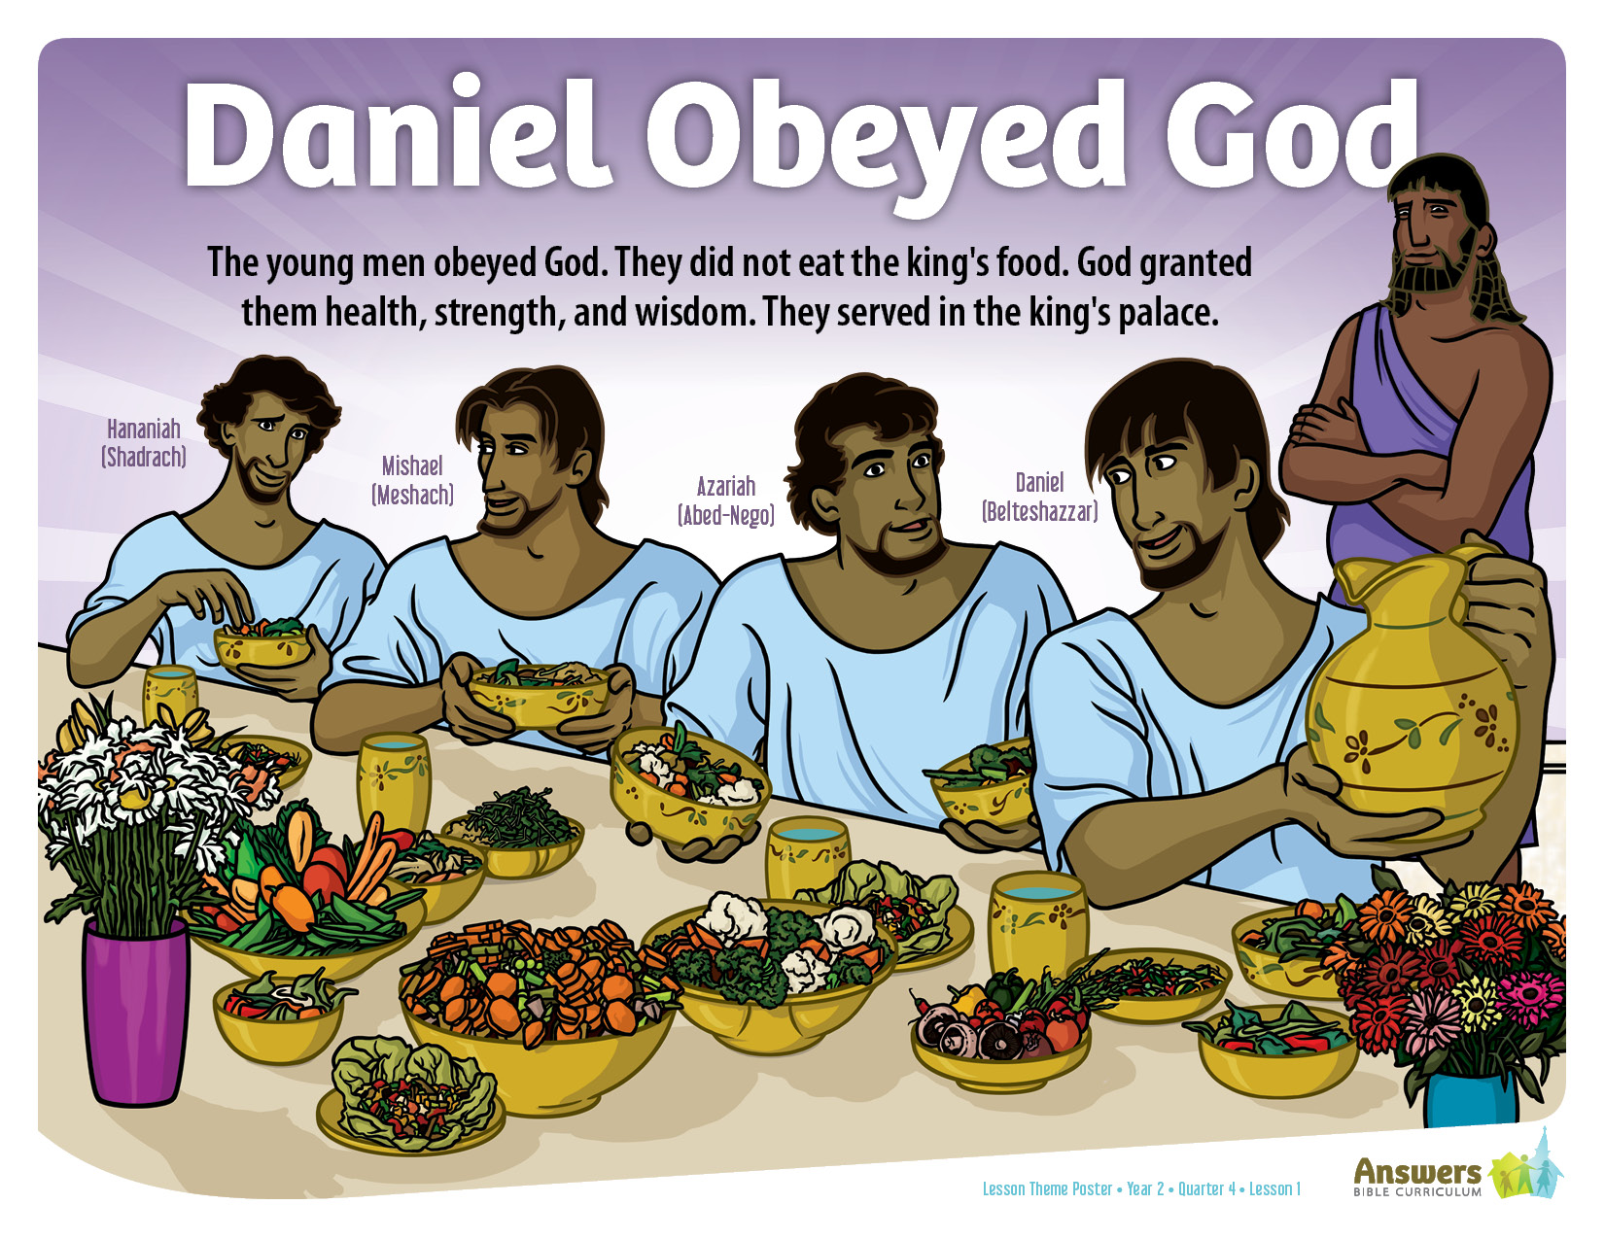
Notes:
ABC Y2Q4L1 Lesson Theme Poster

Slide 2
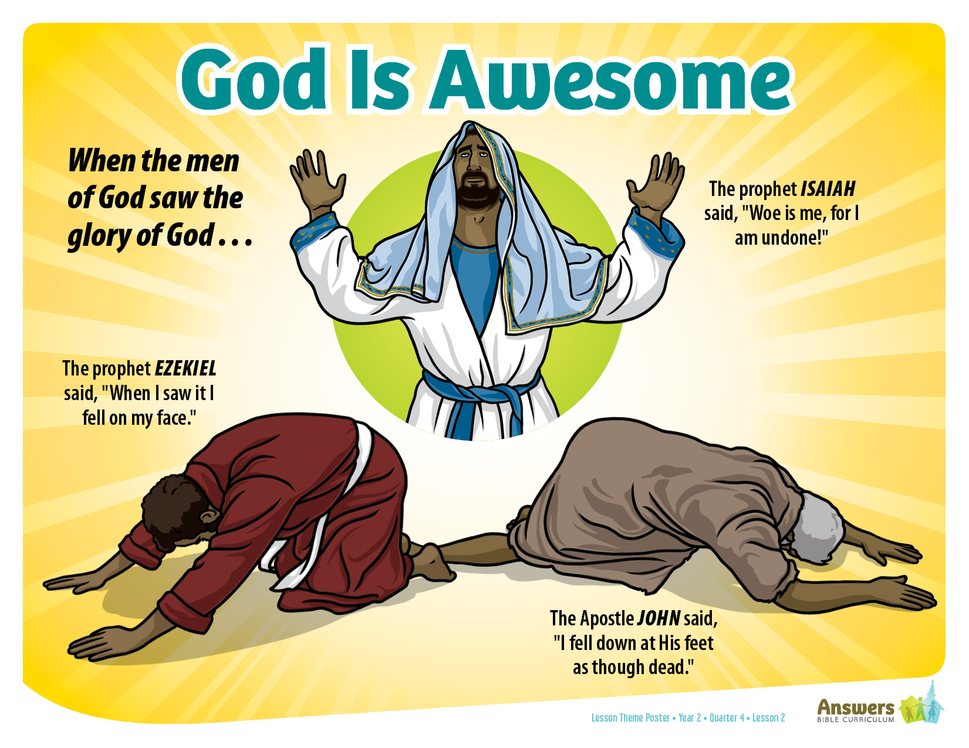
Notes:
ABC Y2Q4L2 Lesson Theme Poster

Slide 3
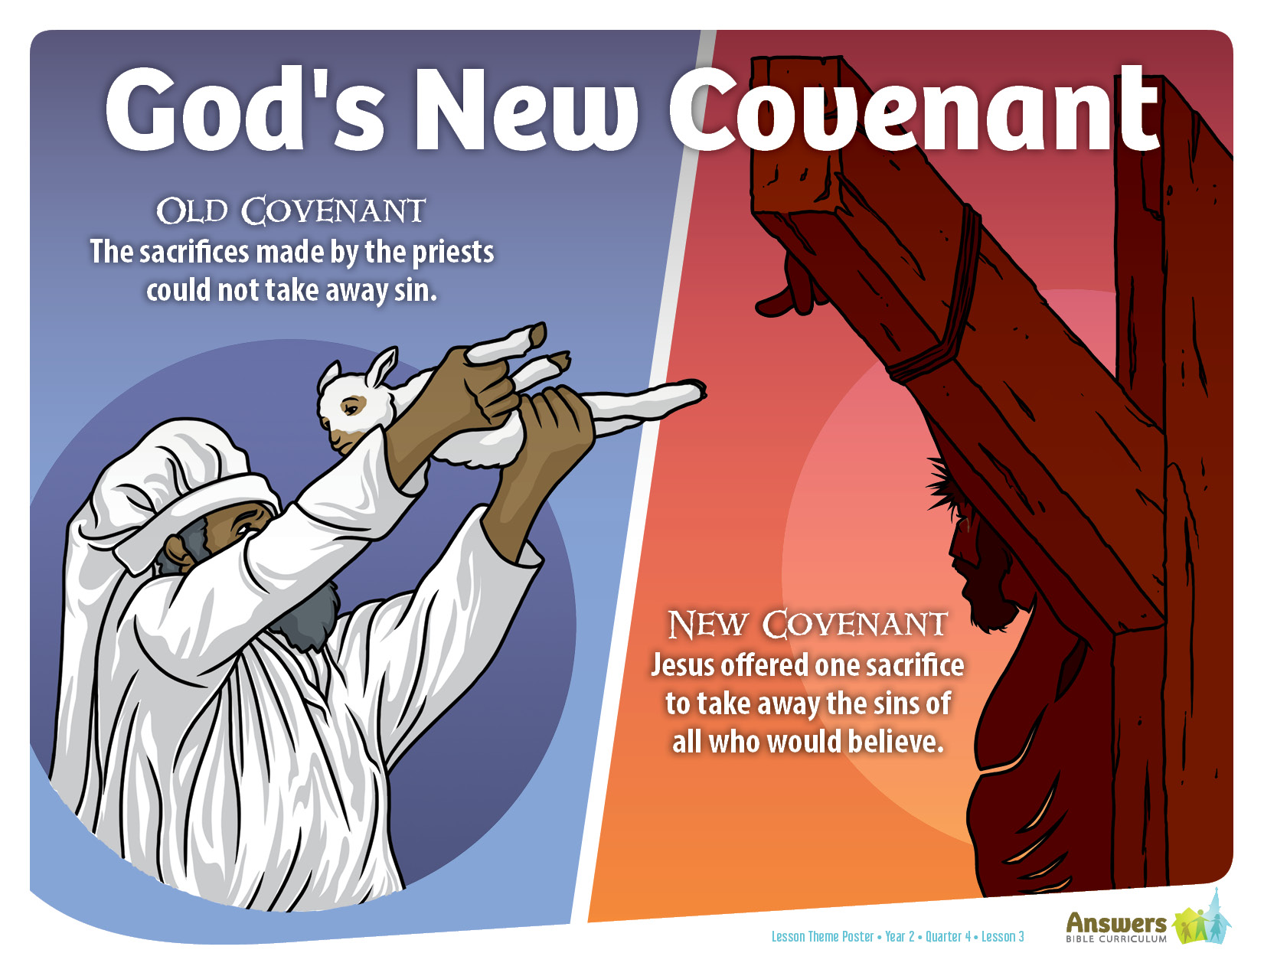
Notes:
ABC Y2Q4L3 Lesson Theme Poster

Slide 4
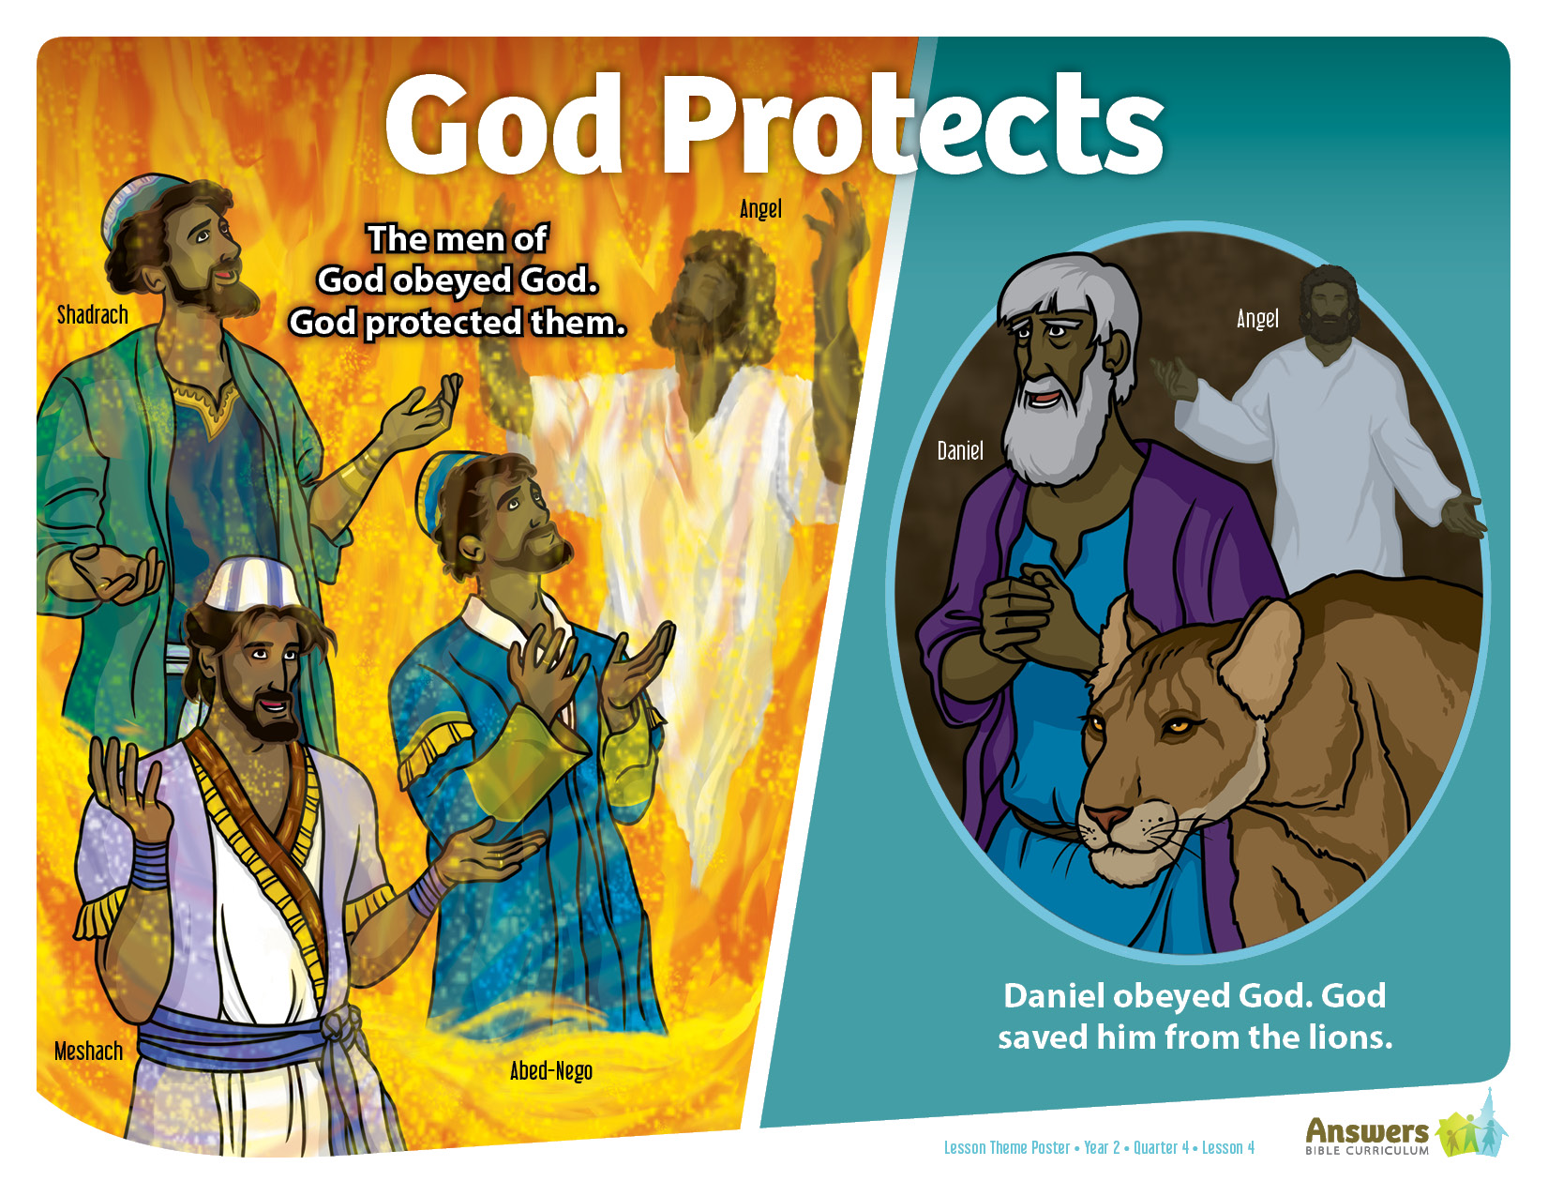
Notes:
ABC Y2Q4L4 Lesson Theme Poster

Slide 5
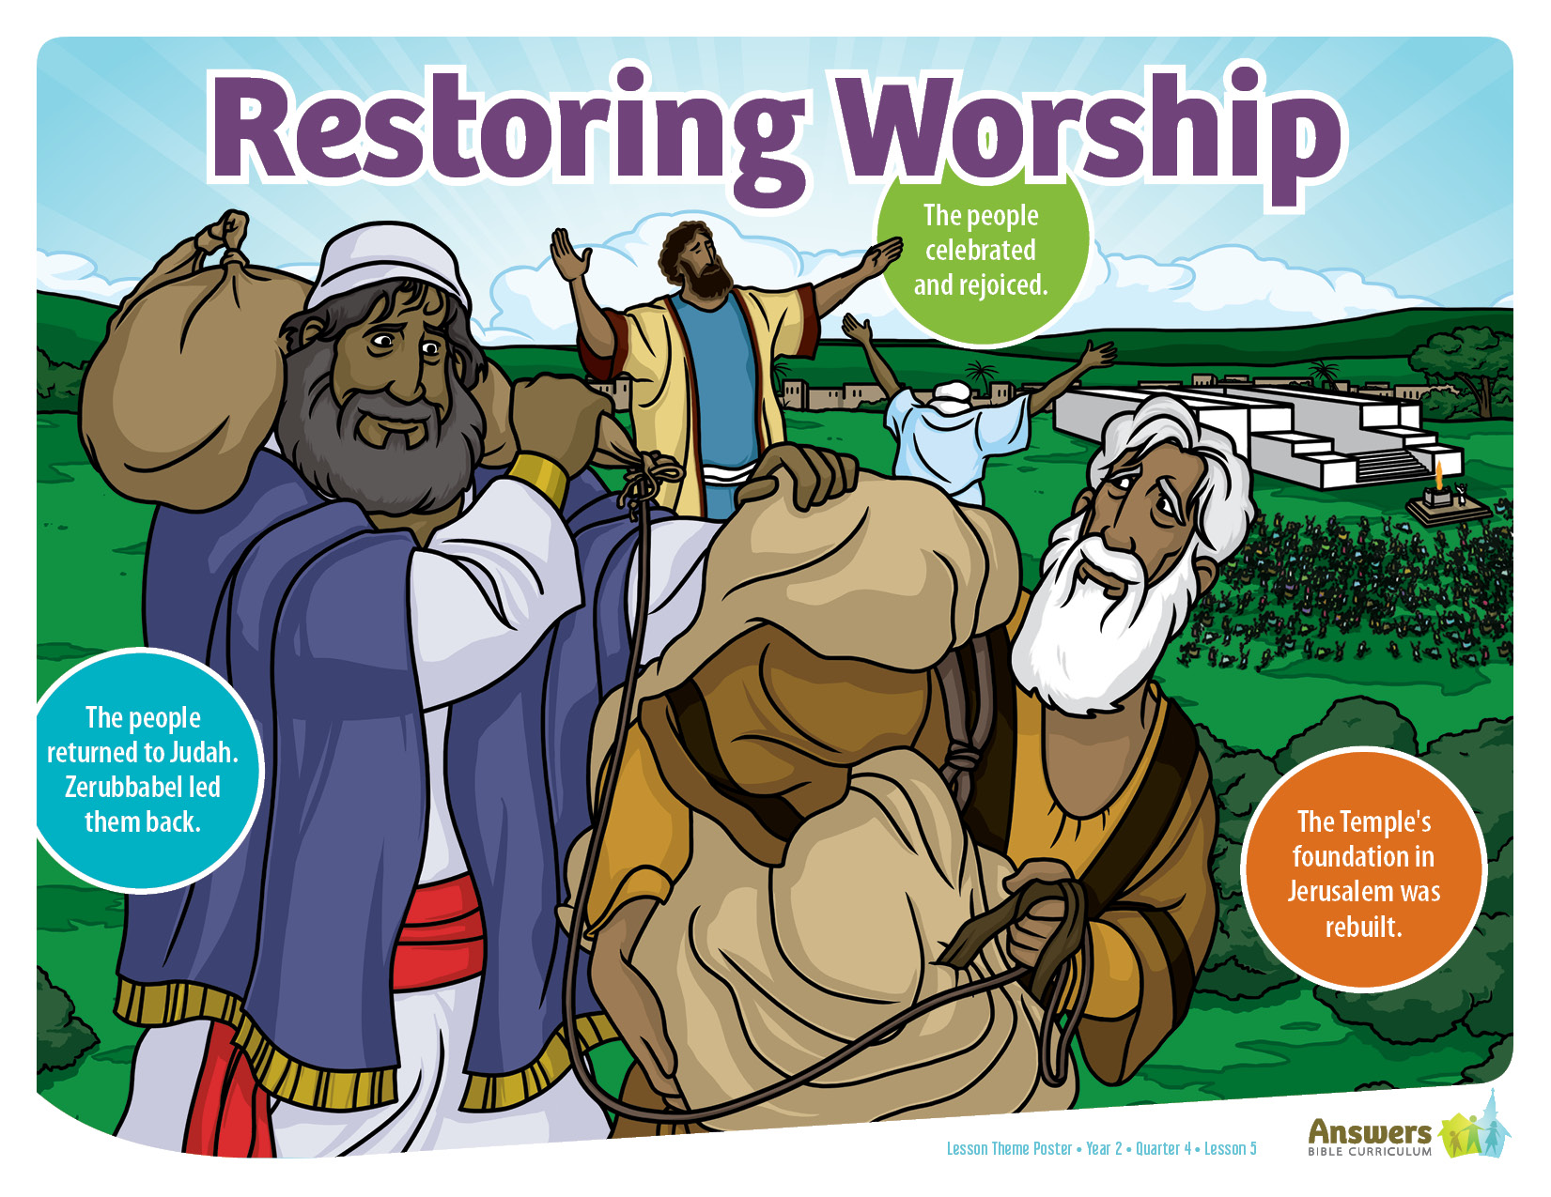
Notes:
ABC Y2Q4L5 Lesson Theme Poster

Slide 6
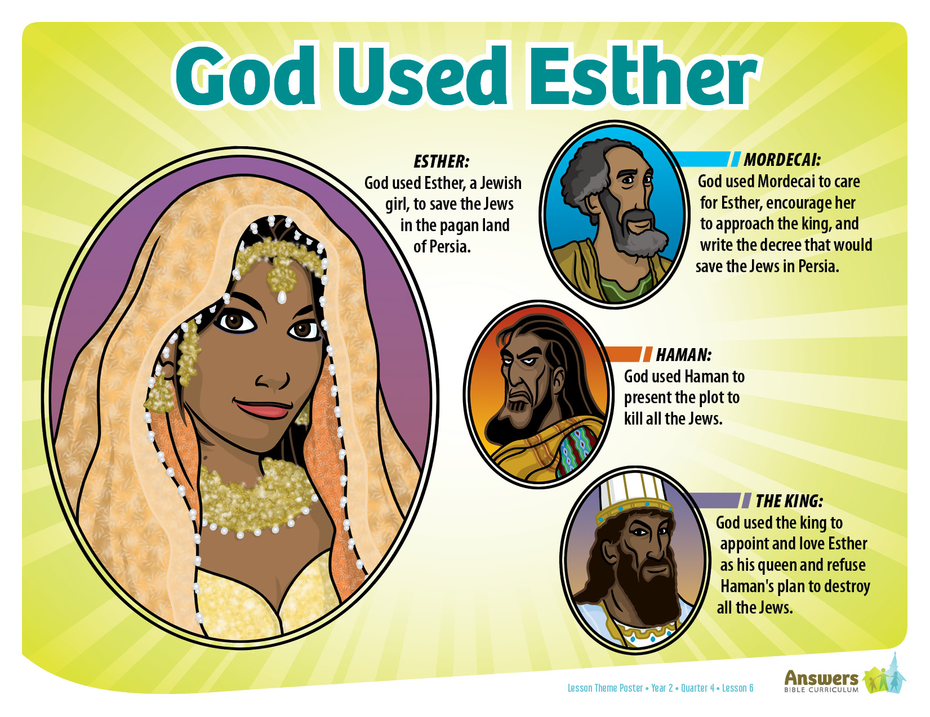
Notes:
ABC Y2Q4L6 Lesson Theme Poster

Slide 7
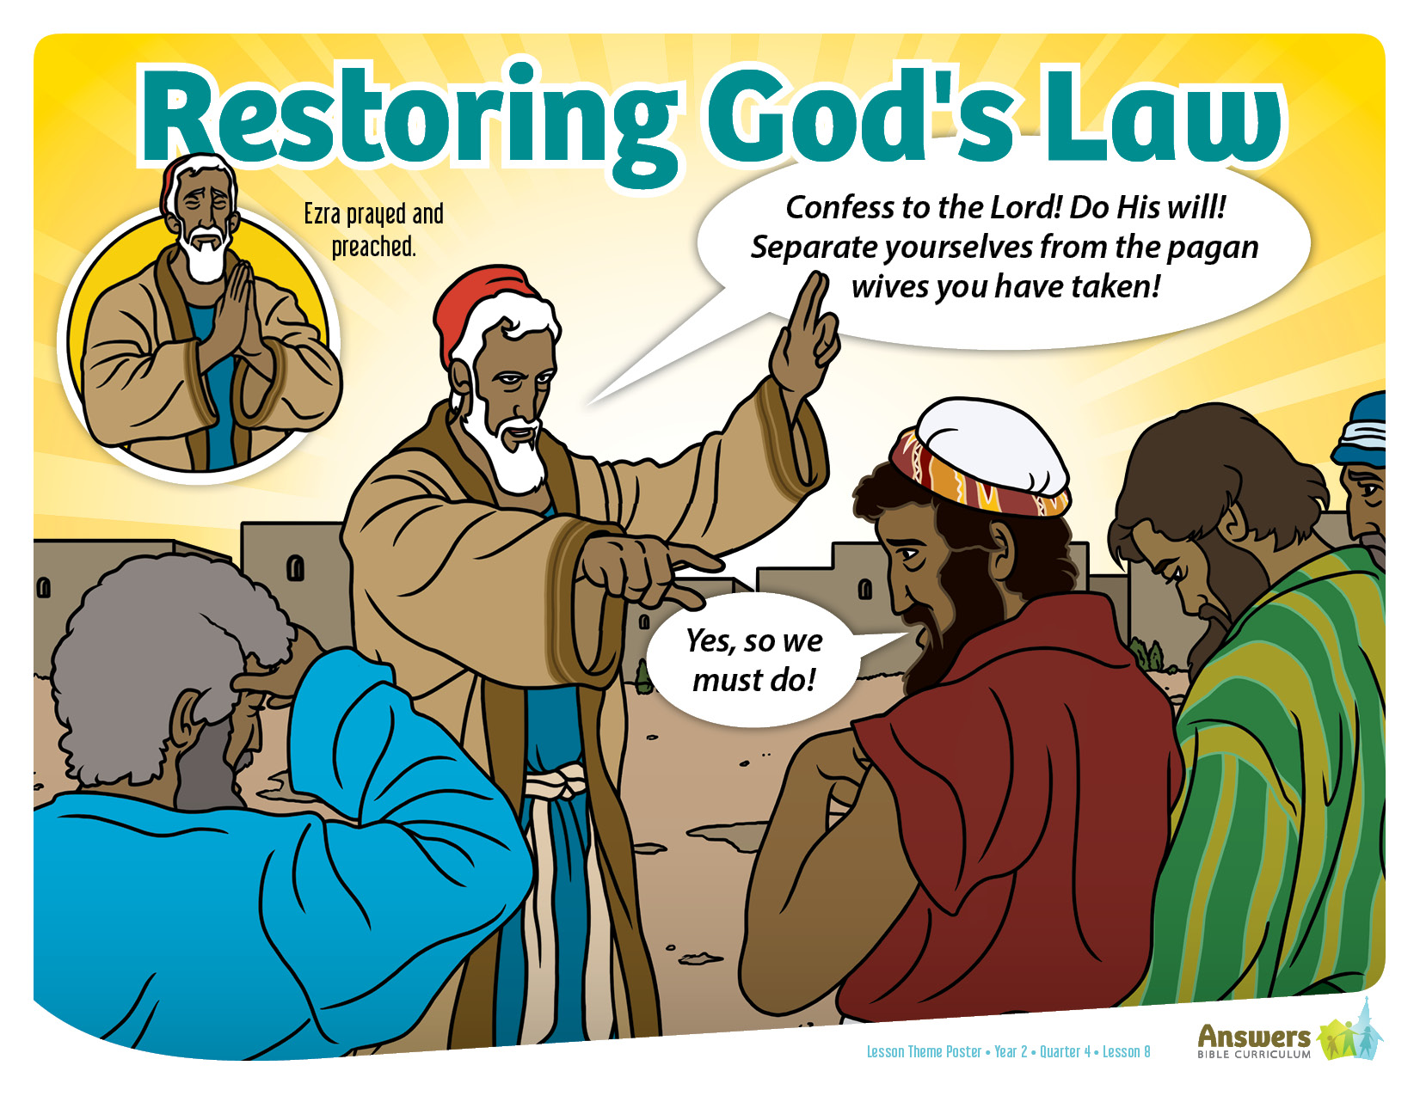
Notes:
ABC Y2Q4L8 Lesson Theme Poster

Slide 8
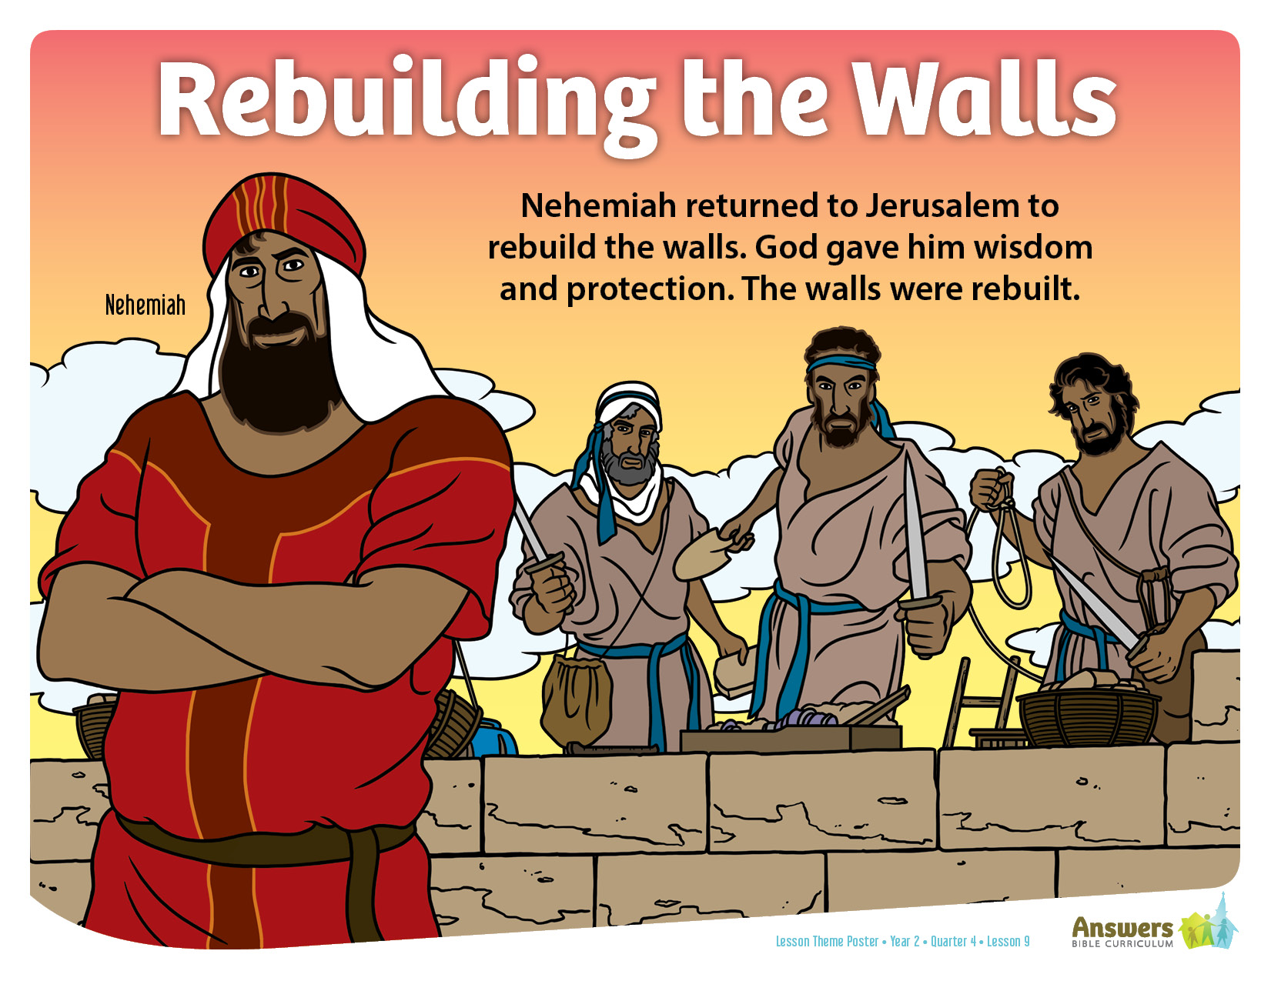
Notes:
ABC Y2Q4L9 Lesson Theme Poster

Slide 9
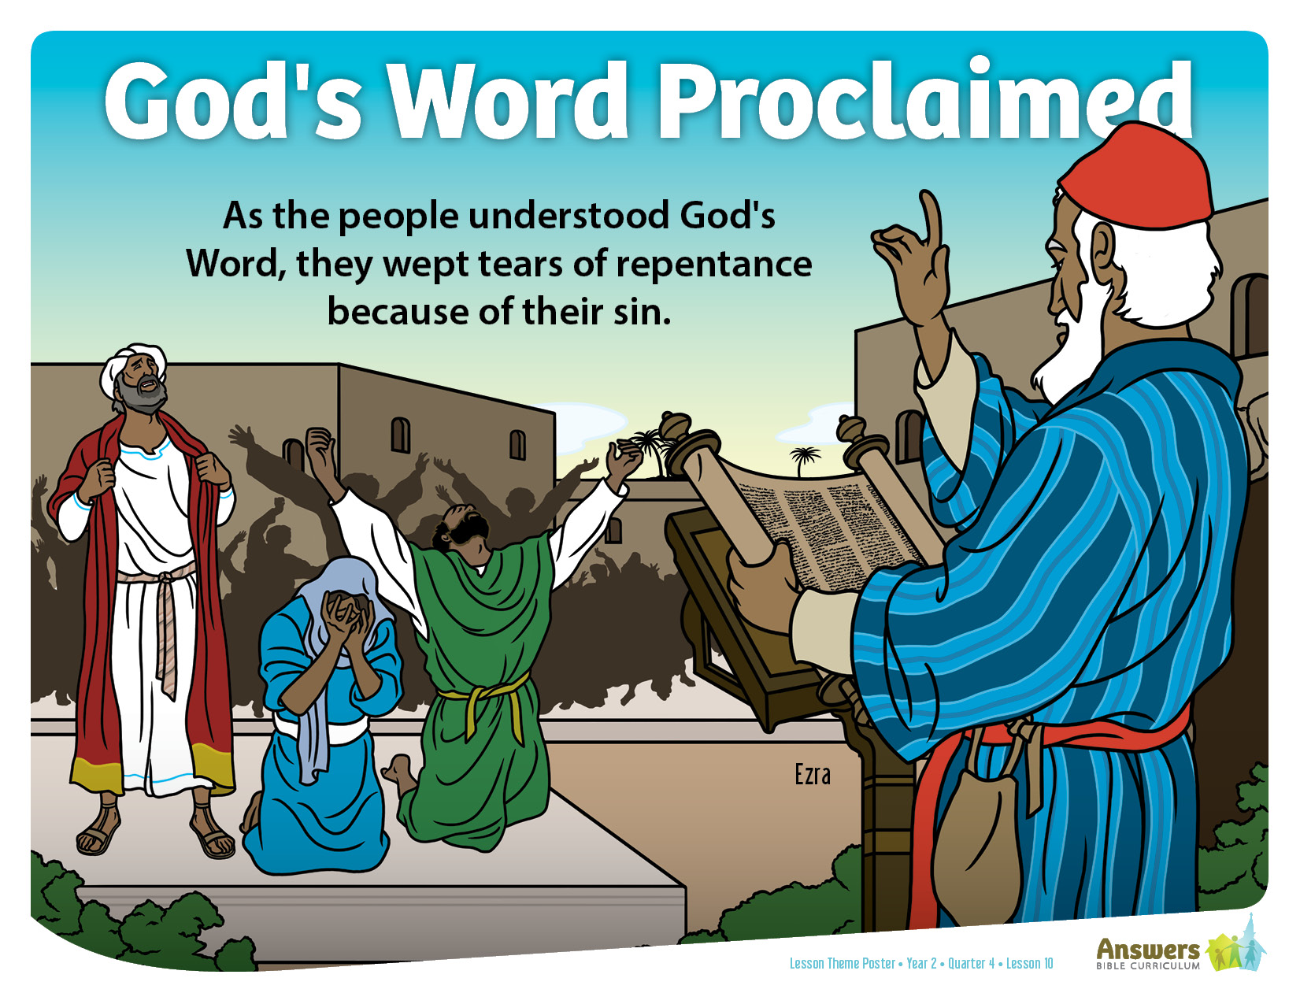
Notes:
ABC Y2Q4L10 Lesson Theme Poster

Slide 10
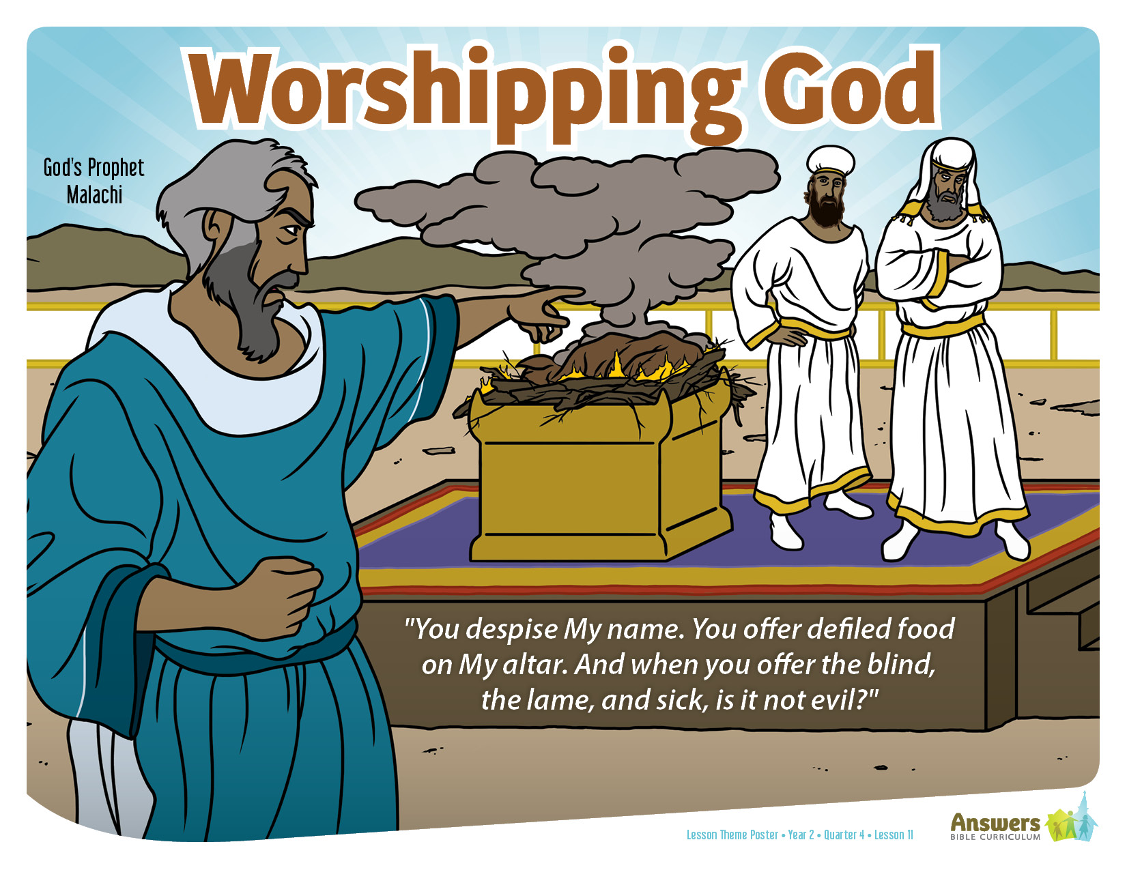
Notes:
ABC Y2Q4L11 Lesson Theme Poster

Slide 11
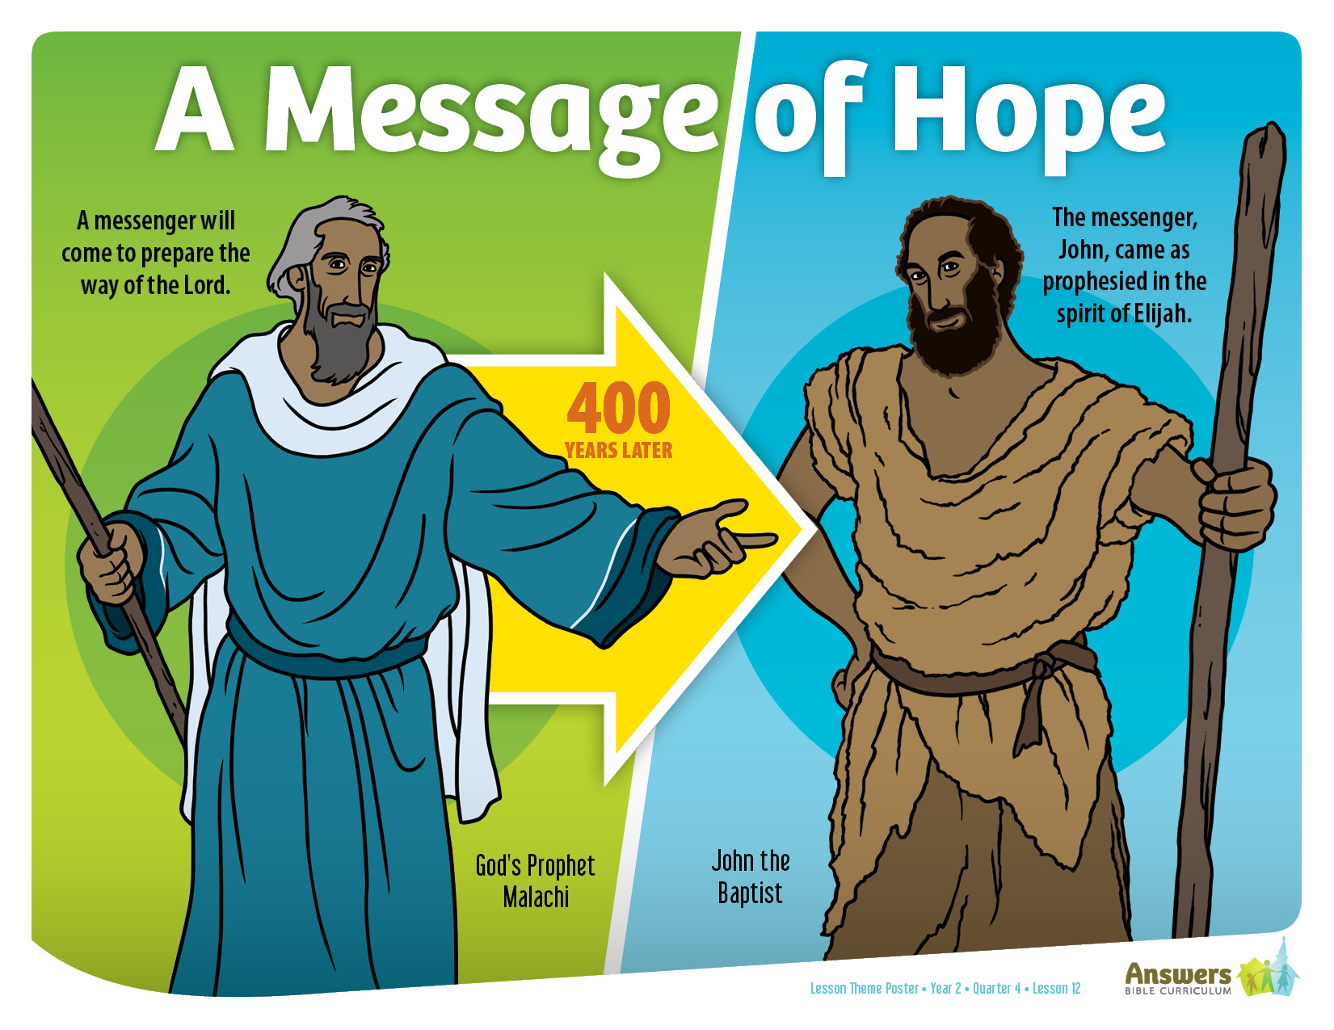
Notes:
ABC Y2Q4L12 Lesson Theme Poster

